Slide 1
Problem solving with fractions and ratios
Understanding multiplicative relationships: fractions and ratio

Slide 2
how to use Oak lessons

Slide 3
I can use my knowledge of fractions and ratios to solve problems.

Slide 4
Variables are in proportion if they have a constant multiplicative relationship.
A ratio shows the relative sizes of 2 or more values and allows you to compare a part with another part in a whole.

Slide 5

Problem solving with fractions and ratios
Strategies to solve ratio problems
Problems involving fractions and ratios

Slide 6

Strategies to solve ratio problems
The ratio of red to blue counters in a bag is 3 ∶ 5
There are 30 blue counters.
Where should the 30 be labelled in a bar model of this problem?
30
30
30 ÷ 5 = 6
5 is the part of the ratio that represents blue counters, so this part has a value of 30
We will now take a look at what problems the other bar models were representing.

Slide 7
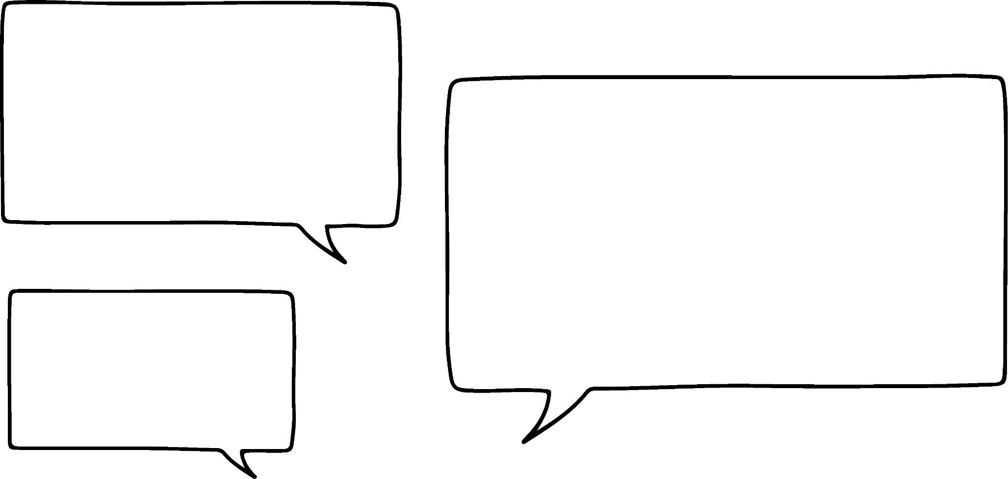

Strategies to solve ratio problems
30 ÷ 3 = 10
Red counters
10 | 10 | 10
8 × 10 = 80
?
Blue counters
10 | 10 | 10 | 10 | 10
I think the bar model is saying that there are 30 red counters and how many counters are there altogether.
Do you agree with Sam?
Yes, the 30 is over the red bar and the question mark is around the whole model.
Sam

Slide 8

Strategies to solve ratio problems
Red counters
30 ÷ 2 = 15
15 | 15 | 15
8 × 15 = 120
?
Blue counters
15 | 15 | 15 | 15 | 15
Therefore, it must be there are 30 more blue than red counters in the bag. How many counters are there in total?
I don’t think I’ve seen a bar model with the bracket there before.
The 30 is above the extra blue parts.
Yes, I think you are right Sam. But I am sure we can work it out.
Sam
Do you agree with Jacob?
Jacob
Yes, the 30 is over the 2 extra blue parts.

Slide 9
Strategies to solve ratio problems
Sam and Jacob share some sweets in the ratio of 3 : 7
?
3 × 3 = 9
Sam
3 | 3 | 3
12 ÷ 4 = 3
Sam gets 9 sweets.
 |  |  | 3 | 3 | 3 | 3
Jacob
3 | 3 | 3
How many am I going to get then?
I am going to get 12 more than you.
Sam
Jacob

Slide 10
Strategies to solve ratio problems
We can solve different types of ratio problems with bar models. Here are a few of the most common:
Type | What to look for
Given the total | Have you been told the total amount that needs to be shared or has been split?
Given one part | Have you been given only what one part of the ratio is? For example, just one colour of counters or just one person’s share?
Given the difference | Have you been given how much more or less one part is than the other? Look for the words more or less or difference.

Slide 11
Strategies to solve ratio problems
Identify the type of question each of these are.
Have you been given the total, one part or the difference?
The ratio of red to blue cars in a car park is 5 : 2. There are 15 more red cars. How many blue cars are there?
The ratio of squash to water in a drink is 1 : 6. You use 25 ml of squash how much water should you use?
2 charities divide £350 in the ratio of 2 : 5.
The ratio of children to adults in a club is 2 : 3. If there are 12 children, how many are in the club in total?

Slide 12
Strategies to solve ratio problems
Identify the type of question each of these are.
Have you been given the total, one part or the difference?
The ratio of red to blue cars in a car park is 5 : 2. There are 15 more red cars. How many blue cars are there?
The ratio of squash to water in a drink is 1 : 6. If you use 25 ml of squash how much water should you use?
2 charities divide £350 in the ratio of 2 : 5.
The ratio of children to adults in a club is 2 : 3. If there are 12 children, how many are in the club in total?
Difference
One part
Total
One part

Slide 13
Strategies to solve ratio problems
The ratio of red to blue cars in a car park is 5 : 2
There are 15 more red cars.
How many blue cars are there?
Although in this question we are finding the ‘other’ part, to set up the question we only know the difference between the two parts.
 |  | 5 | 5 | 5
Red
5 | 5
15 ÷ 3 = 5
Blue
5 | 5
?
2 × 5 = 10
There are 10 blue cars.

Slide 14
Strategies to solve ratio problems
The ratio of squash to water in a drink is 1 : 6
You use 25 ml of squash. How much water should you use?
25
This is the the ‘other’ part in the ratio.
Squash
25
25 | 25 | 25 | 25 | 25 | 25
You should use 150 ml of water.
Water
6 × 25 = 150
?

Slide 15
Strategies to solve ratio problems
2 charities divide £350 in the ratio of 2 : 5
The total to be shared.
2 × 50 = £100
?
Charity A received £100 and charity B received £250.
Charity A
50 | 50
350 ÷ 7 = 50
Charity B
50 | 50 | 50 | 50 | 50
?
5 × 50 = £250

Slide 16
Strategies to solve ratio problems
The ratio of children to adults in a play centre is 2 : 3. If there are 12 children, how many are in the play centre in total?
12 ÷ 2 = 6
The total to be found and one ‘part’ known.
Children
6 | 6
There are 30 people in total at the play centre.
?
5 × 6 = 30
Adults
6 | 6 | 6

Slide 17

Strategies to solve ratio problems
Match each problem to its corresponding bar model.
1) The ratio of red to blue is 5 : 3. There are 120 red. How many are there in total?
2) The ratio of red to blue is 5 : 3. There are 120 in total. How many red are there?
3) The ratio of red to blue is 5 : 3. There are 120 fewer blue. How many red are there?
4) The ratio of red to blue is 5 : 3. There are 120 blue. How many red are there?
?
?
120
120
?
120
?
a
120
b
c
d

Slide 18
Strategies to solve ratio problems
Match each problem to its corresponding bar model.
3) The ratio of red to blue is 5:3. There are 120 fewer blue. How many red are there?
4) The ratio of red to blue is 5:3. There are 120 blue. How many red are there?
2) The ratio of red to blue is 5:3. There are 120 in total. How many red are there?
1) The ratio of red to blue is 5:3. There are 120 red. How many are there in total?
?
?
120
120
?
120
?
a
120
b
c
d

Slide 19

Strategies to solve ratio problems
Bar models can be really useful and you don’t need to draw them exactly to scale but there are certain things you need to make sure of to solve a problem correctly.
Can you spot the error in the bar model of this problem?
The ratio of lemon to chocolate cakes left on a stall is 4 : 7. If there are 12 more chocolate cakes, how many cakes are there in total?
6 | 6 | 6 | 6
12
So, there are 66 cakes in total.
4 | 4 | 4 | 4
12
6 | 6 | 6 | 6 | 6 | 6 | 6
4 | 4 | 4 | 4 | 4 | 4 | 4

Slide 20
Strategies to solve ratio problems
Use the ratio to check you have labelled the correct number of parts.
For example, 4 ∶ 7
The difference is 3 parts, 7 − 4 = 3

Slide 21
Strategies to solve ratio problems
Solve these problems.
You may want to draw a bar model to help you.
To make the required shade of paint you need to mix blue and white paint in the ratio of 2 : 5
If you have 210 ml of blue paint, how much white paint do you need?
If you need to make 210 ml in total, how much of each colour do you need?
If you used 210 ml more white paint than blue paint, how much paint was made in total?
If you have 210 ml of white paint, how much blue paint do you need?

Slide 22
Strategies to solve ratio problems
To make the required shade of paint you need to mix blue and white paint in the ratio of 2 : 5
If you have 210 ml of blue paint, how much white paint do you need?
210
? = 5 × 105 = 525
So you need 525 ml of white paint.
105 | 105
Blue paint
105 | 105 | 105 | 105 | 105
White paint
?

Slide 23
Strategies to solve ratio problems
To make the required shade of paint you need to mix blue and white paint in the ratio of 2 : 5
b) If you need to make 210 ml in total, how much of each colour do you need?
Blue paint:
2 × 30 = 60
White paint:
5 × 30 = 150
60 ml of blue paint and 150 ml of white paint.
?
30 | 30
Blue paint
210
30 | 30 | 30 | 30 | 30
White paint
?

Slide 24
Strategies to solve ratio problems
To make the required shade of paint you need to mix blue and white paint in the ratio of 2 : 5
c) If you used 210 ml more white paint than blue paint, how much paint was made in total?
? = 7 × 70 = 490
So 490 ml in total.
70 | 70
Blue paint
210
?
70 | 70 | 70 | 70 | 70
White paint

Slide 25
Strategies to solve ratio problems
To make the required shade of paint you need to mix blue and white paint in the ratio of 2 : 5
d) If you have 210 ml of white paint, how much blue paint do you need?
?
? = 2 × 42 = 84
You need 84 ml of blue paint.
42 | 42
Blue paint
42 | 42 | 42 | 42 | 42
White paint
210

Slide 26
Problem solving with fractions and ratios
Strategies to solve ratio problems
Problems involving fractions and ratios

Slide 27


Problems involving fractions and ratios
Sofia counts 300 red, blue and white cars in a car park.
The ratio of red to blue cars is 2 : 3
of the cars are white.
How many of each colour are there in the car park?
This is my first step to solve this problem.
Has Andeep chosen the correct way to start solving this problem?
No, he has forgotten about the white cars. The 300 is the total of the red, blue and white cars.
Andeep
300

Slide 28
Problems involving fractions and ratios
Sofia counts 300 red, blue and white cars in a car park.
The ratio of red to blue cars is 2 : 3
of the cars are white.
How many of each colour are there in the car park?
The first step is to find the number of white cars.
of 300 = × 300 = 3 × 30 = 90
Number of red and blue = 300 − 90 = 210

Slide 29

Problems involving fractions and ratios
The ratio of red to blue cars is 2 : 3
We now know that there are 210 red and blue cars in the car park.
What fraction of the cars are red?
of the cars are red.
As I have used fractions to solve the first part I think I will continue.
of 210 = × 210 = 2 × 42 = 84
Number of blue = 210 − 84 = 126
There are 90 white cars, 84 red cars and 126 blue cars.
Andeep

Slide 30

Problems involving fractions and ratios
Aisha is 3 times as old as her younger brother Benji.
Benji is two-fifths of their cat’s age.
The total of Aisha’s and Benji’s ages is 16.
What is the total of their ages?
Aisha = 12
Benji =
Cat =
The ratio of Aisha’s age to Benji’s age is what?
A : B
3 : 1
What fraction of their total age is Aisha?
Aisha is of their total age.
Aisha’s age = × 16 = 3 × 4 = 12

Slide 31
Problems involving fractions and ratios
Aisha is 3 times as old as her younger brother Benji.
Benji is two-fifths of their cat’s age.
The total of Aisha’s and Benji’s ages is 16.
What is the total of their ages?
Aisha = 12
Benji = 4
Cat = 10
Benji’s age = 16 − Aisha’s age
12
Benji’s age = 4
Benji’s age = × c
4 = × c
Total age = 12 + 4 + 10 = 26 years
c = 4 ÷ = 10

Slide 32

Problems involving fractions and ratios
Spot the mistake.
A bag of sweets contains red, green and yellow sweets.
of the bag are red.
The rest of the sweets are either green or yellow, in the ratio 3 : 5.
There are 72 sweets in the bag.
How many of each colour are there?
3 × 9 = 27
Red × 72 = 24
Green
Yellow
9 | 9 | 9
72 ÷ 8 = 9
9 | 9 | 9 | 9 | 9
5 × 9 = 45
The red sweets are not subtracted from the total before finding the green and yellow sweets.
What could have been done to check the answer and spot the mistake?
Finding the total of the red, green and yellow sweets gives 96 sweets and there were only 72 in the bag!

Slide 33
Problems involving fractions and ratios
A bag of sweets contains red, green and yellow sweets.
of the bag are red.
The rest of the sweets are either green or yellow, in the ratio 3 : 5
There are 72 sweets in the bag.
How many of each colour are there?

Slide 34

Problems involving fractions and ratios
2) Izzy counts 350 red, blue and white cars in a car park.
The ratio of red to blue cars is 2 : 3
of the cars are white.
How many of each colour are there in the car park?

Slide 35
Problems involving fractions and ratios
3) Andeep’s older sister Belle is 5 times his age.
The cat is three-tenths of Belle’s age.
The total of Andeep’s and Belle’s ages is 24.
What is the total of their ages?

Slide 36
Problems involving fractions and ratios
A bag of sweets contains red, green and yellow sweets.
of the bag are red.
The rest of the sweets are either green or yellow, in the ratio 3 : 5
There are 72 sweets in the bag.
How many of each colour are there?
Red = 24
Green = 18
Yellow = 30
Check 24 + 18 + 30 = 72

Slide 37
Problems involving fractions and ratios
2) Izzy counts 350 red, blue and white cars in a car park.
The ratio of red to blue cars is 2 : 3
of the cars are white.
How many of each colour are there in the car park?
White = 200
Red = 60
Blue = 90

Slide 38
Problems involving fractions and ratios
3) Andeep’s older sister Belle is 5 times his age.
The cat is three-tenths of Belle’s age.
The total of Andeep’s and Belle’s ages is 24.
What is the total of their ages?
Andeep = 4
Belle = 20
Cat = 6
Total age = 30

Slide 39
Problem solving with fractions and ratios
In a ratio problem you may be given the total, one part or the difference between the parts.
Using and labelling a bar model can help you solve problems involving ratio.
Because fractions and ratios are alternative ways of showing proportion they can be interchanged when solving problems. It is not always necessary to find all ‘parts’.

Slide 40

© Oak National Academy 2023.
Produced in partnership with Mathematics in Education and Industry.
Licensed on the Open Government Licence v3.0, except where otherwise stated. See Oak terms and conditions.

